Slide 1


IT Service Ticket Analysis

Slide 2
Table of contents
01
02
03
04
05
06
Statement
Hypothesis
Objectives
Methodology
Analysis
Conclusions

Slide 3
Purpose statement
Overview of the Dataset and Key Attributes
This project analyses IT service tickets to identify trends, issues, and opportunities for improving service delivery. The dataset includes various fields such as rtus_opened_by, rtus_resolved_by, rtim_u_inc_short_desc, rtus_u_component, rtim_u_inc_priority, Resolution period, and others, which capture detailed information about each ticket, including its lifecycle from creation to resolution.

Slide 4
Current situation & problems statement
Current situation
Problems
Inconsistent Resolution Times
The current dataset comprises IT service tickets, detailing the lifecycle of each ticket from creation to resolution. These tickets are logged by various store divisions and components within the organization, each associated with different incident priorities, types, and resolution times. The goal is to utilize this data to improve service delivery, enhance customer satisfaction, and adhere to SLA
1
2
Unclear Impact of ticket Priority
3
Lack of Clear RCA

Slide 5
Hypotheses
Initial Assumptions and Expected Outcomes
I hypothesize that certain factors, such as the region (Store Division), incident priority, and number of reassignments, have a significant impact on resolution times.
I expected to find that higher-priority incidents are resolved faster but may involve more resources and that incidents requiring multiple reassignments take longer to resolve.

Slide 6
Study objectives
Identify key factors influencing resolution times.
Assess the impact of reassignments and transfers on resolution efficiency
Provide actionable insights to improve service delivery and SLA adherence.
Determine the most common reasons for ticket creation

Slide 7
Methodology
Data Cleaning
Handle missing values, standardize date formats, and ensure consistency in data entries.
Steps Taken to Prepare and Analyze the Data
Used Power Query to transform and shape the data as needed.
Data Transformation
Descriptive Analysis
Created visuals like histograms, tree map, slicers and pie charts to understand data distribution
Diagnostic Analysis
Develop more complex visuals like Sankey diagrams, time series analyses, and scatter plots to identify patterns and relationships.

Slide 8
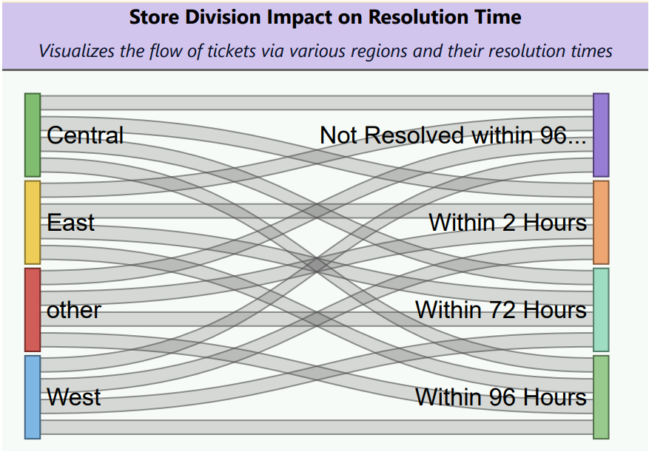
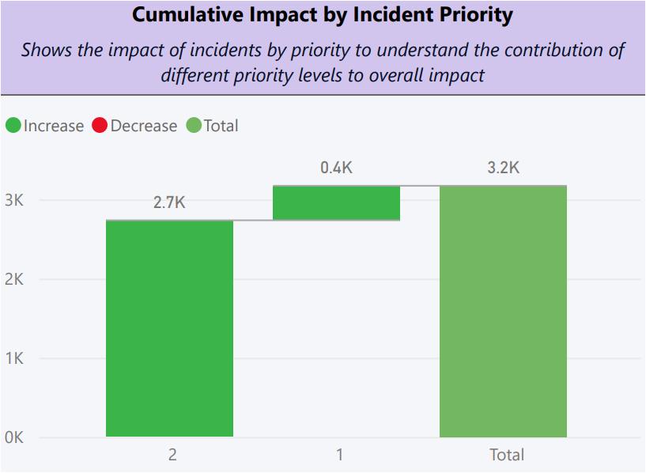
Analysis & development
Sankey Diagram: Store Division Impact on Resolution Time
Visualizes the flow of tickets through various regions and their resolution times.
Histogram: Cumulative Impact by Incident Priority
Shows the cumulative impact of incidents by priority to understand performance trends over time.

Slide 9
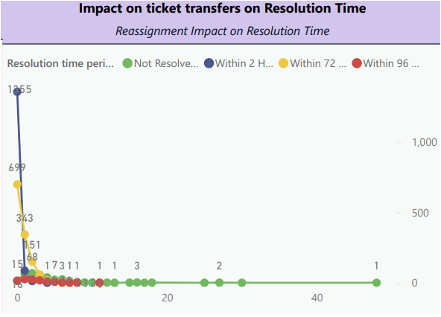
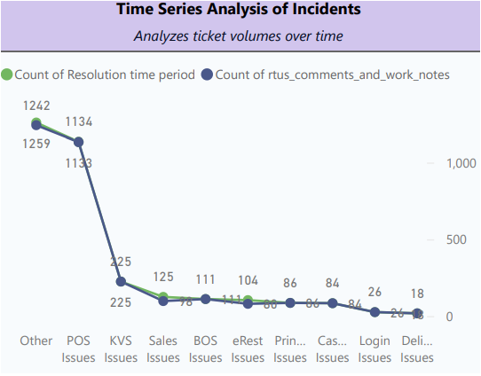
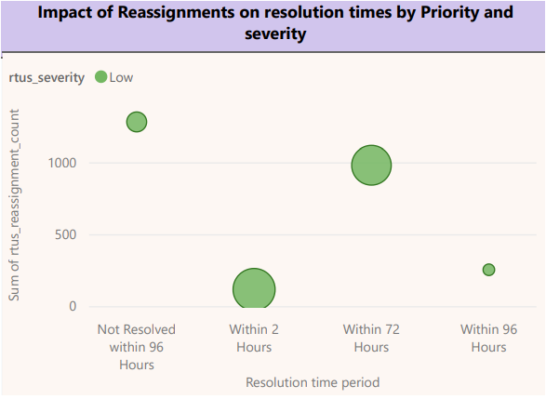
Line Graph
Impact of Reassignments on Resolution Times by Priority and Severity- Tracks how reassignments affect resolution times based on priority and severity.
Impact on Ticket Transfers on Resolution Times- Analyzes how transfers between teams or individuals impact resolution efficiency.
Scatter Plot:
Impact on Ticket Transfers on Resolution Times - Examines how ticket transfers influence resolution times.

Slide 10
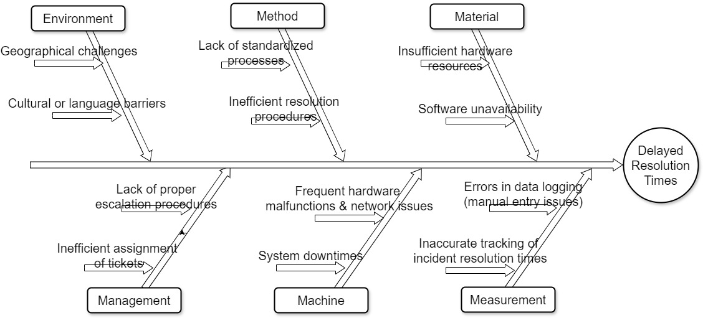
Factors contributing to Delayed Resolution Time
Objective: To identify and analyze factors contributing to delayed resolution times. Hypothesis: Multiple interrelated factors influence resolution times; addressing these can reduce delays and improve efficiency.

Slide 11
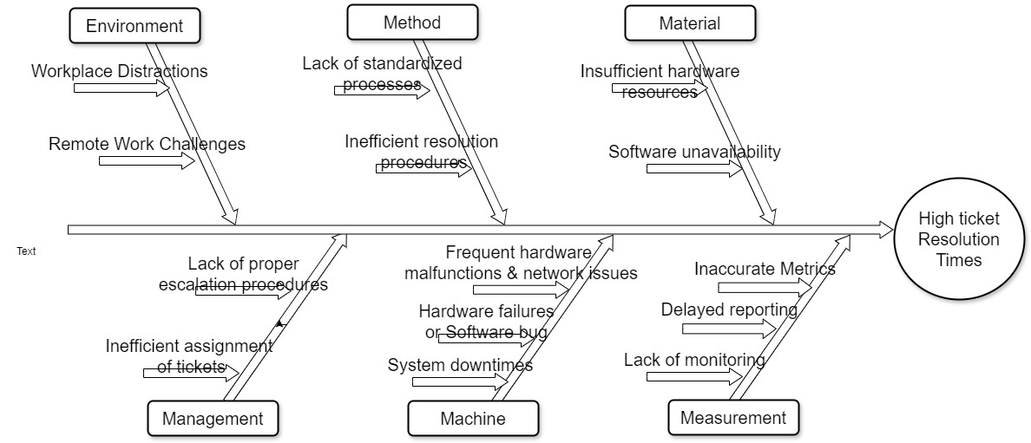
Factors contributing to High Ticket Resolution Time
Objective: To identify and analyze factors contributing to high ticket resolution times. Hypothesis: Multiple interrelated factors influence resolution times; addressing these can improve efficiency.

Slide 12
Recommendations and Implementation Plan
Short-term (1-3 months)
Identify and reduce key workplace distractions.
Standardize ticket resolution processes.
Ensure adequate hardware resources are available.
Streamline ticket assignment procedures.
Medium-term (3-6 months)
Enhance communication and collaboration tools for remote work.
Optimize software availability and uptime.
Develop clear escalation procedures.
Long-term (6-12 months)
Invest in reliable hardware and network infrastructure.
Implement preventive maintenance protocols.
Establish robust monitoring and reporting systems.

Slide 13
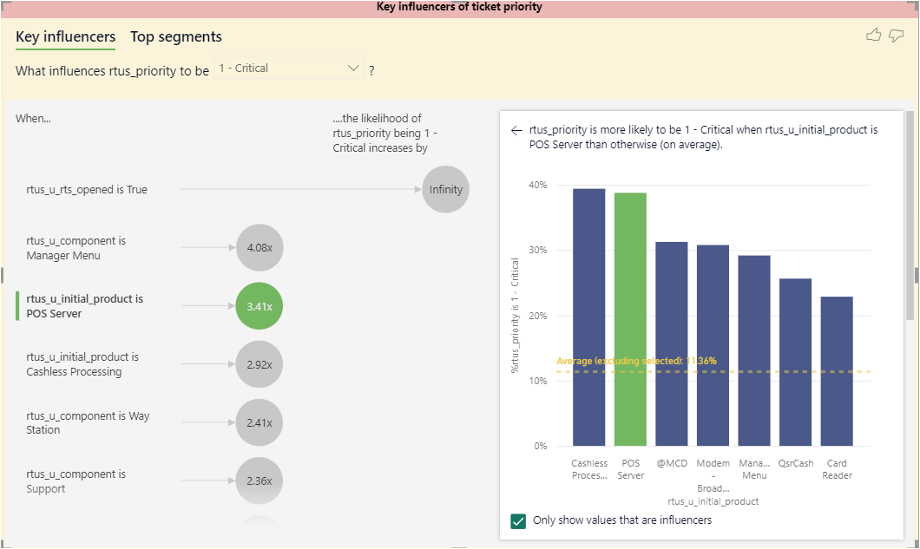
Key Influencers by Ticket Priority - Critical (1)
Observation: Tickets associated with POS servers are highly likely to be categorized as critical. This is because issues with POS servers directly impact sales operations, leading to significant business disruptions.
Implication: POS server issues need immediate resolution to minimize downtime and ensure continuous business operations.
Recommendation: Develop specialized teams and protocols specifically for handling POS server issues. Additionally, implement monitoring tools that can detect and address potential POS server problems before they escalate.

Slide 14
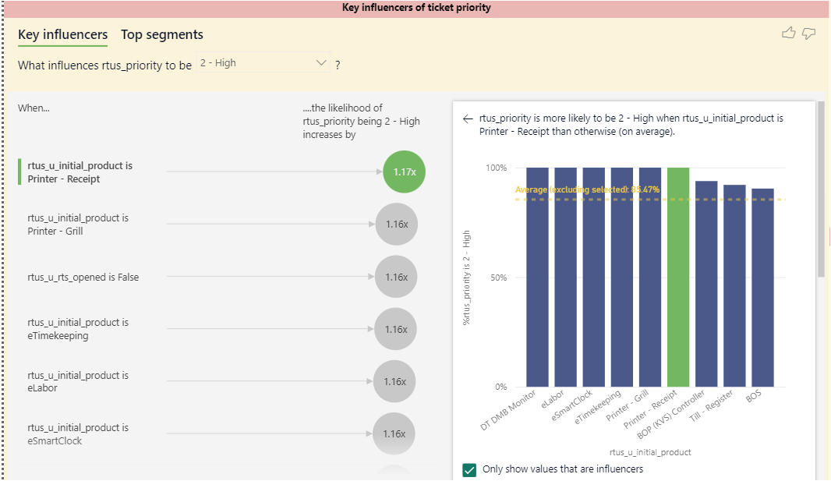
Key Influencers by ticket priority - Critical (2)
Observation: Tickets related to printer receipt issues are frequently classified as high priority. This shows that printer receipt problems are critical for day-to-day operations, particularly in retail environments.
Implication: Ensuring printers function correctly is essential to maintain workflow efficiency and avoid operational bottlenecks.
Recommendation: Ensure adequate support and maintenance for printer receipt devices. Train staff to handle these issues efficiently and keep spare parts readily available to reduce downtime.

Slide 15
Anomaly Detection
I have identified a few common Anomalies, and they are as follows:
High-Priority tickets with POS Servers: Insight: Issues with POS servers are frequently critical. Action: Ensure specialized teams handle these issues with additional training and resources. | Tickets with "Printer Receipt": Insight: These incidents are often high-priority. Action: Implement specific monitoring tools and protocols for printer receipt issues.
Reassignments and Resolution Times: Insight: Frequent reassignments lead to higher resolution times. Action: Streamline assignment procedures and improve communication protocols. | Outliers in Resolution Times: Insight: Some tickets deviate significantly from the average resolution time. Action: Investigate and correct process inefficiencies or errors.
Regional Variations in Resolution Times: Insight: Certain regions have significantly different resolution times. Action: Address unique regional challenges and share best practices.

Slide 16
Trends for Contact Modes Based on Issue Type
Based on the analysis obtained from the dataset, I have identified the trends for each contact mode based on the issues they handle most effectively. Here is the key findings and trends:
Contact type | Usage | Time | Issue Types | Satisfaction
Email | Non-urgent issues and detailed inquiries. | Longer resolution times | Data Discrepancies, User Access Issues. | Mixed satisfaction levels due to delayed responses.
Call | Urgent issues needing immediate attention. | Fastest resolution times, especially for high-priority. | Hardware Issues, Network Issues, POS Issues, System Issues etc. | High satisfaction due to immediate interaction and quick resolution.
Chat | Real-time assistance | Moderate resolution times, faster than email | Application Issues, Cashless Issues, Service Issues, User Access Issues etc. | High satisfaction due to convenience of real-time support.
Self-Service Portal | Issues that can be resolved by the customer using available resources. | Fastest initial response since no human interaction required. | Data Discrepancies, Printer Issues, Service Issues etc. | High satisfaction if user-friendly; frustration if not resolved.

Slide 17
Conclusions
Identified key factors affecting resolution times, including region, priority, and reassignments.
I have highlighted the most common reasons for ticket creation and areas needing improvement.
Suggested actionable steps to streamline processes, reduce resolution times, and enhance SLA adherence.
Proposed further analysis and continuous monitoring to ensure ongoing improvements.

